Slide 1

In a class hierarchy, when a method in a subclass has the same return type and signature as a method in its superclass, then the method in the subclass is said to override the method in the superclass.
When an overridden method is called from within a subclass, it will always refer to the version of that method defined by the subclass.
The version of the method defined by the superclass will be hidden.

Slide 2
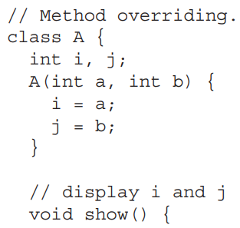


Slide 3
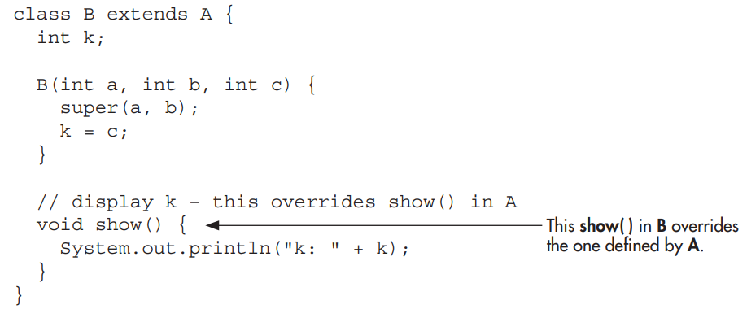

Slide 4
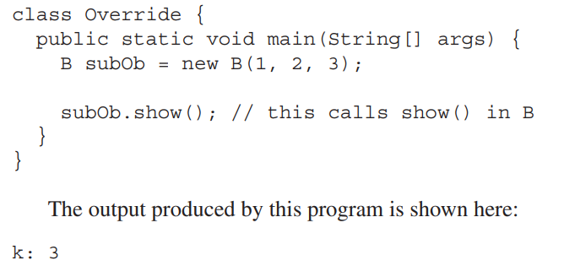

Slide 5
When show( ) is invoked on an object of type B, the version of show( ) defined within B is used. That is, the version of show( ) inside B overrides the version declared in A.

Slide 6
If you want to access the superclass version of an overridden method, you can do so by using super.
For example, in this version of B, the superclass version of show( ) is invoked within the subclass’ version. This allows all instance variables to be displayed.

Slide 7
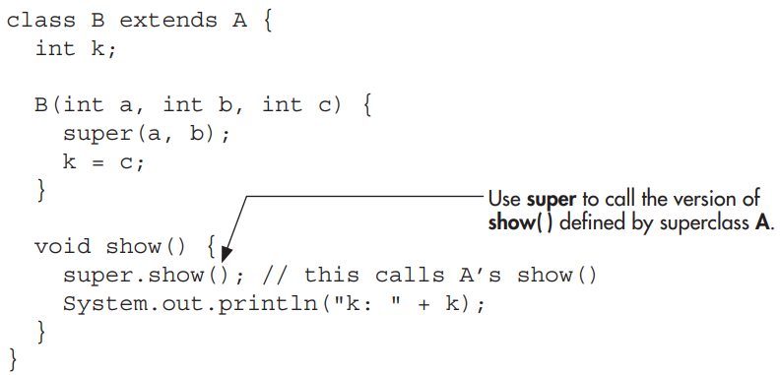

Slide 8

If you substitute this version of show( ) into the previous program, you will see the following output:

Slide 9
Method overriding occurs only when the signatures of the two methods are identical.
If they are not, then the two methods are simply overloaded. For example, consider this modified version of the preceding example:

Slide 10
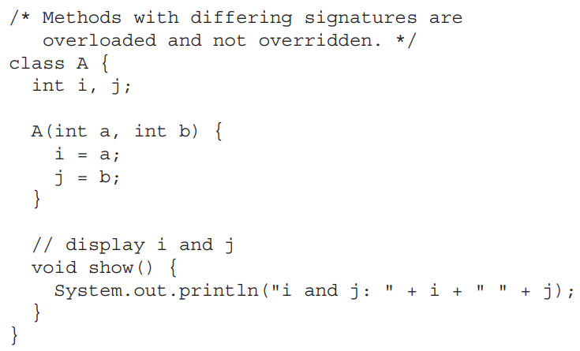

Slide 11
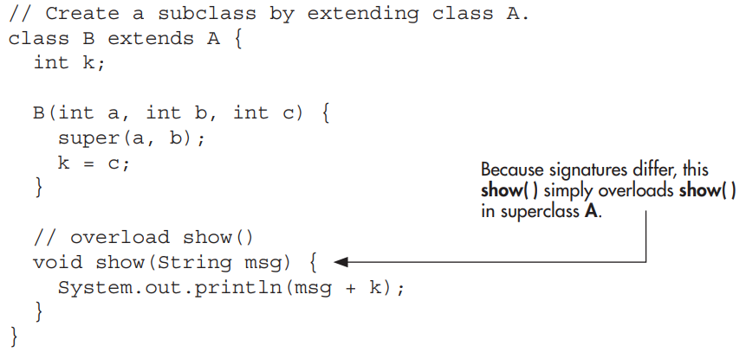

Slide 12

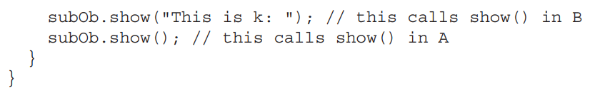
The version of show( ) in B takes a string parameter. This makes its signature different from the one in A, which takes no parameters. Therefore, no overriding (or name hiding) takes place.

Slide 13
While the examples in the preceding section demonstrate the mechanics of method overriding, they do not show its power.
Method overriding forms the basis for one of Java’s most powerful concepts: dynamic method dispatch.

Slide 14
Dynamic method dispatch is the mechanism by which a call to an overridden method is resolved at run time rather than compile time.
Dynamic method dispatch is important because this is how Java implements run-time polymorphism.

Slide 15
Let’s begin by restating an important principle: a superclass reference variable can refer to a subclass object.
Java uses this fact to resolve calls to overridden methods at run time.
Here’s how. When an overridden method is called through a superclass reference, Java determines which version of that method to execute based upon the type of the object being referred to at the time the call occurs.

Slide 16
Thus, this determination is made at run time.
When different types of objects are referred to, different versions of an overridden method will be called.
Therefore, if a superclass contains a method that is overridden by a subclass, then when different types of objects are referred to through a superclass reference variable, different versions of the method are executed.

Slide 17
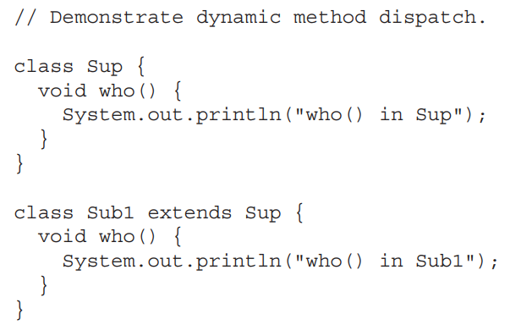
Here is an example that illustrates dynamic method dispatch:

Slide 18
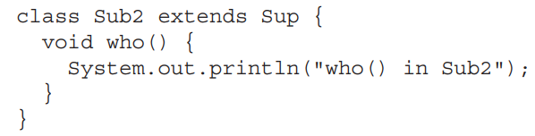

Slide 19
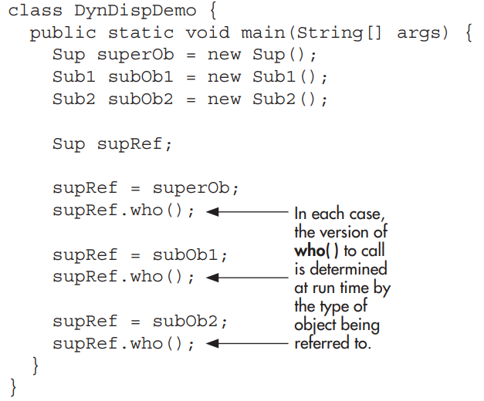

Slide 20
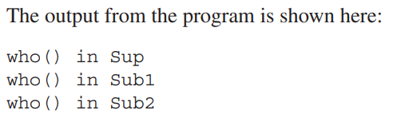

Slide 21

As stated earlier, overridden methods allow Java to support run-time polymorphism.
Polymorphism is essential to object-oriented programming for one reason: it allows a general class to specify methods that will be common to all of its derivatives, while allowing subclasses to define the specific implementation of some or all of those methods.

Slide 22
Overridden methods are another way that Java implements the “one interface, multiple methods” aspect of polymorphism.
Part of the key to successfully applying polymorphism is understanding that the superclasses and subclasses form a hierarchy that moves from lesser to greater specialization.

Slide 23
This allows the subclass the flexibility to define its own methods, yet still enforces a consistent interface.
Thus, by combining inheritance with overridden methods, a superclass can define the general form of the methods that will be used by all of its subclasses

Slide 24
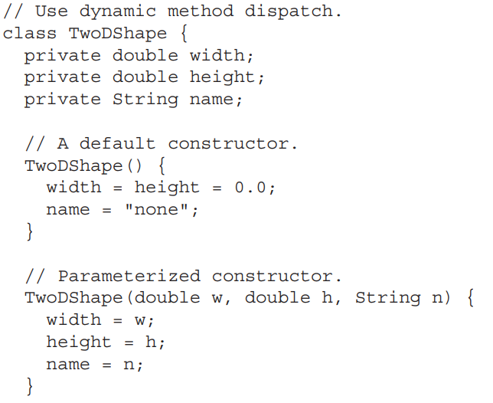

Slide 25
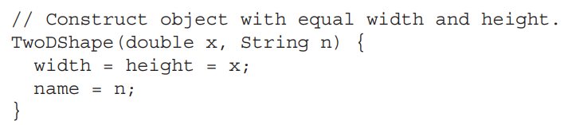
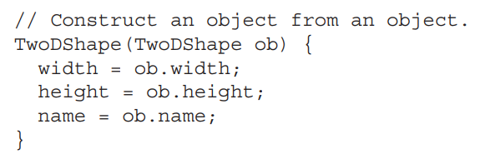

Slide 26
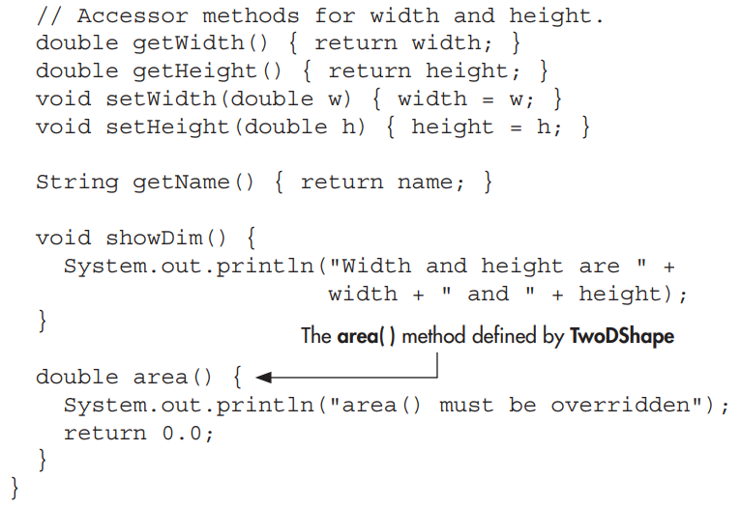

Slide 27
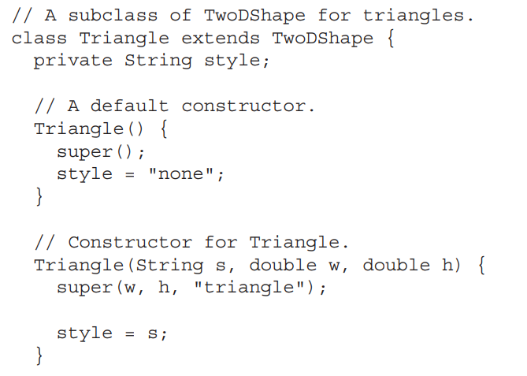

Slide 28
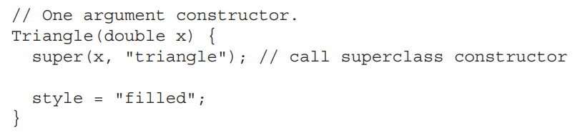
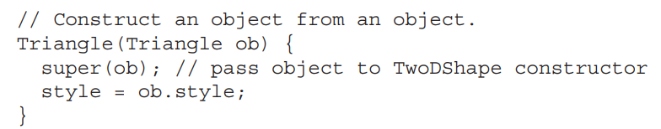

Slide 29
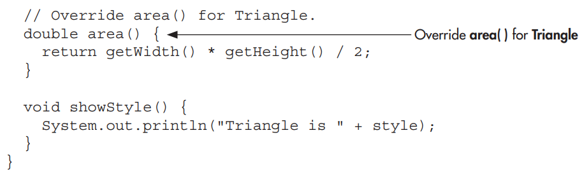

Slide 30
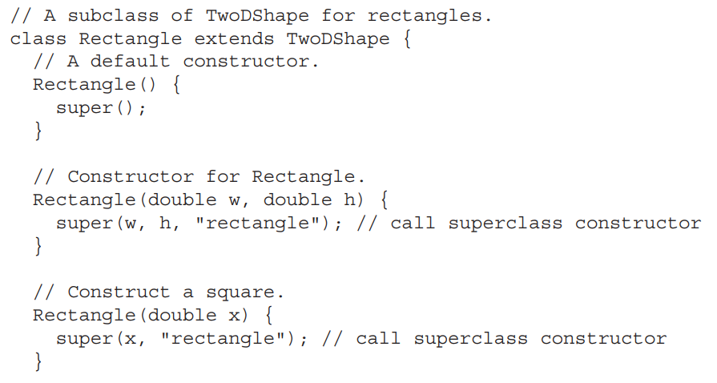

Slide 31
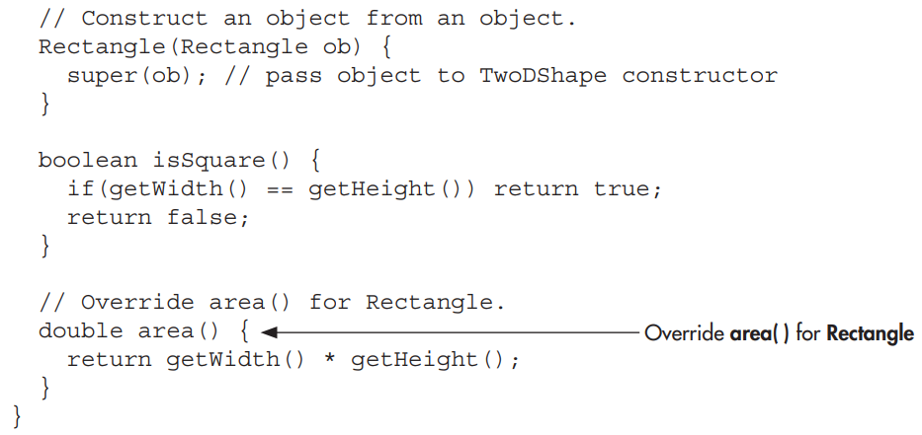

Slide 32
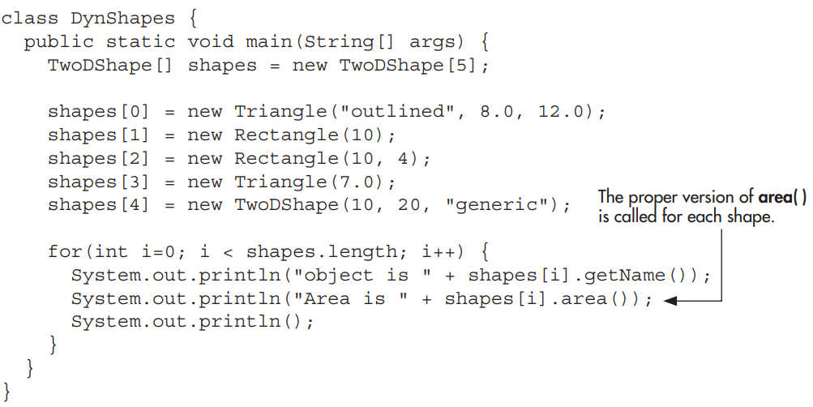

Slide 33
